Slide 1
Team 516
Lunar Dust Glovebox
Design Review 6
March 25th, 2025
Notes:
Good afternoon everyone, We are Team 516 and today we will be talking about our design and progress for the Lunar Dust Glovebox Project

Slide 2
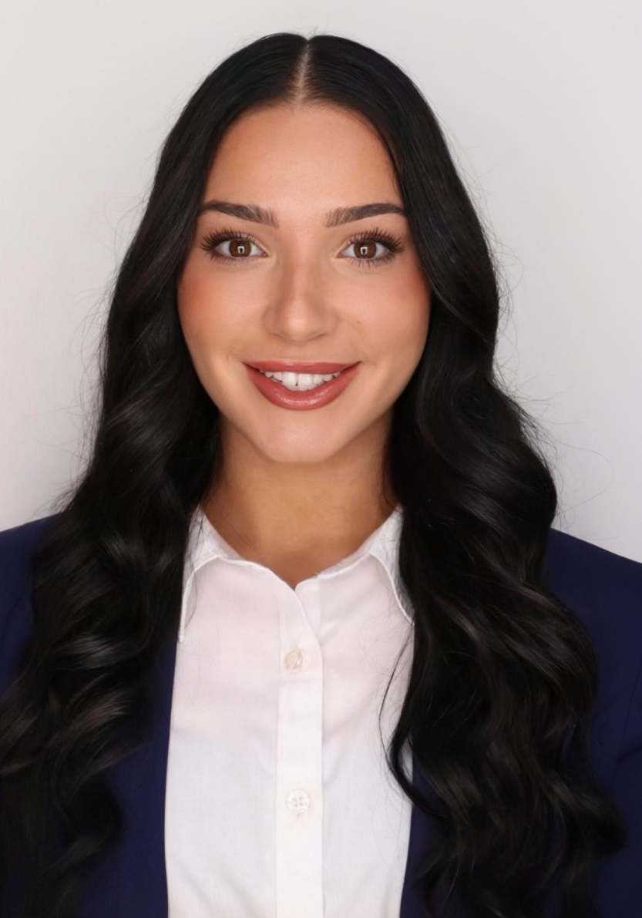
Introductions:
Our Team
All
Mina Brahmbhatt
Systems Housing and Controls Team
Nia Britton
Systems Housing and Controls Team
Ryan Dreibelbis
CFD Validation and Verification Team
Kendall Kovacs
Materials Management and Validation
Peter Mougey
Systems Housing and Controls Team
Lawrence Terrell
CFD Validation and Verification Team
2
Notes:
Im mina, im nia, im ryna, im kendall, im peter, and im lawrence

Slide 3
Introductions:
Sponsors
Mina Brahmbhatt
Amy Cassady
Orion Integrated Performance Lead
Amy Fritz
JSC Dust Mitigation Technical Lead
Brian Troutman
Human Landing System Crew Compartment Lunar Dust Mitigation Discipline Lead
Thomas Vassiliou
EX2 Spacecraft Performance and Concept Engineering (SPACE) Acting Deputy Branch Chief
Notes:
Here are our sponsors, both the Amy’s, brian (our main point of contact) and thomas

Slide 4
Introductions:
Advisors
Mina Brahmbhatt
Dr. Brandon Krick Associate Professor
Dr. Shayne McConomy
Teaching Faculty II
Notes:
And here are our advisors, both dr krick and dr mcconomy

Slide 5
Project Background:
Objective Statement
Mina Brahmbhatt
The objective of this project is to optimize air flow to evenly distribute lunar dust simulant throughout a lunar dust glovebox.
Notes:
The objective of our project is to optimize air flow to evenly distribute lunar dust simulant throughout a lunar dust glovebox

Slide 6
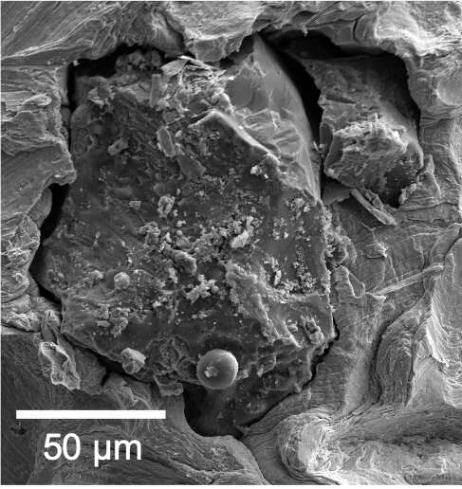
Project Background:
Lunar Dust
Peter Mougey
Fine particles of the lunar surface
40% smaller than a human hair strand
Lunar dust microstructure
Notes:
The particles jagged edges and irregular shape is what leads to it being so harmful to mechanisms and humans. These particles can be very fine, with an average size of around 100 nanometers and bulk density of one point five grams per centimeter cubed

Slide 7
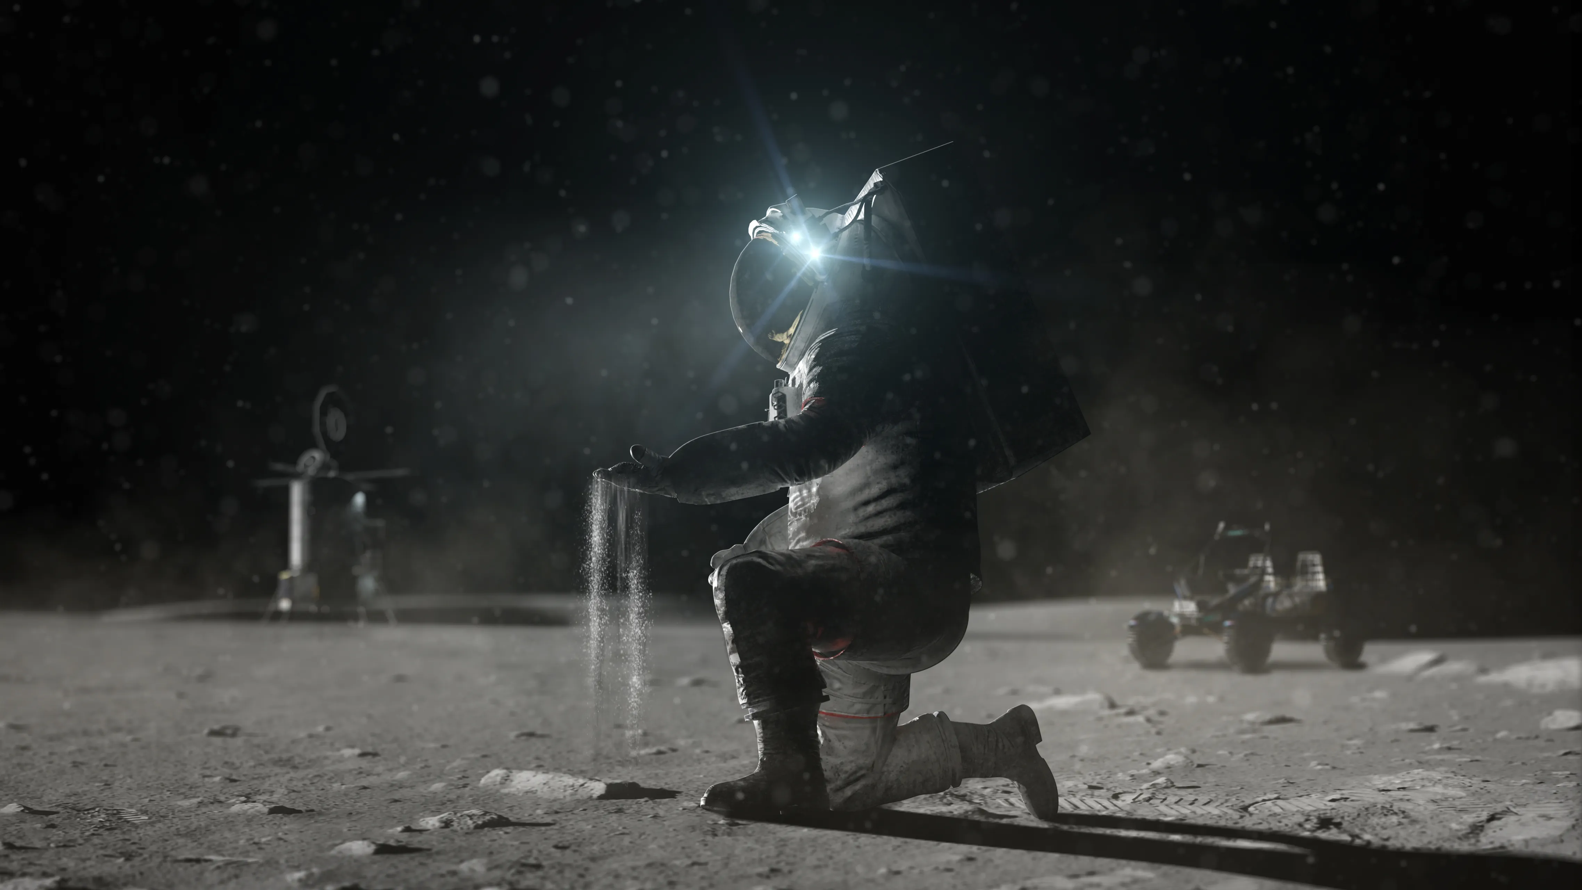
Project Background:
Lunar Dust
Peter Mougey
Lunar dust enters spacesuits at the seams
Notes:
The particles jagged edges and irregular shape is what leads to it being so harmful to mechanisms and humans. These particles can be very fine, with an average size of around 100 nanometers and bulk density of one point five grams per centimeter cubed

Slide 8
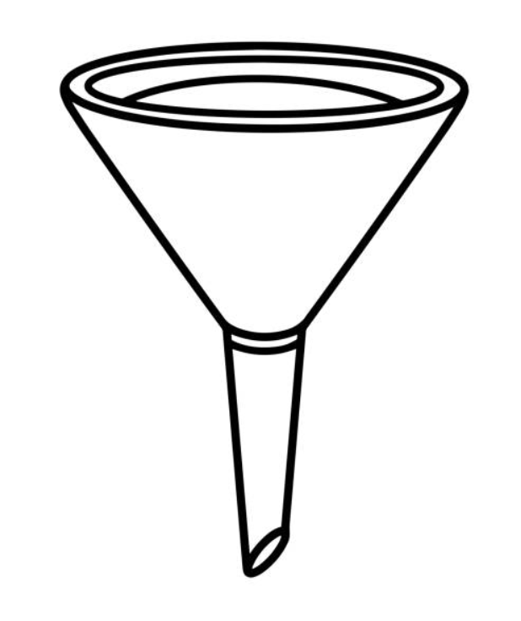
Project Background:
The Problem
Peter Mougey

Slide 9
Project Background:
The Problem
Peter Mougey

Slide 10
Project Background:
The Goal
Peter Mougey

Slide 11
Project Background:
Overall Goals
Peter Mougey
CFD Model
Design and Build
Run Experiment #1
Evaluate Results and Compare with CFD
Refine Glovebox and CFD
Run Experiment #2
Evaluate Results

Slide 12
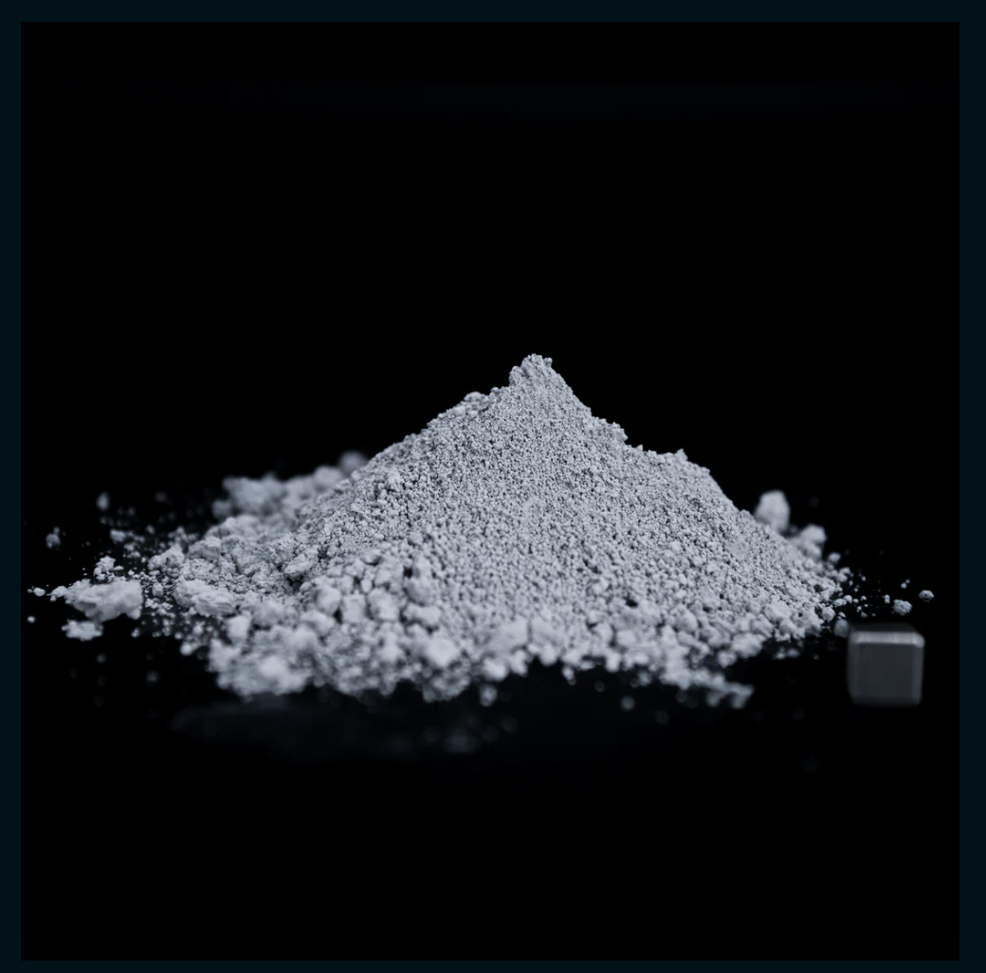
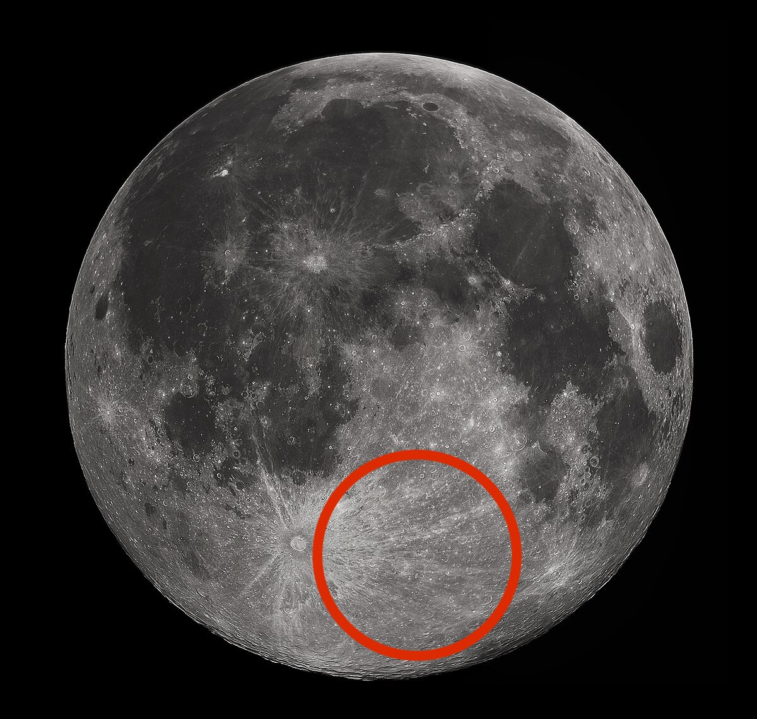
Project Background:
Lunar Highlands Dust Simulant
Kendall Kovacs
LHS-1D:
Lunar Highlands Dust Regolith Simulant
LHS-1D Lunar Dust Simulant
Highlands of the moon
Notes:
-Highlands is from the lighter part of the moon: mainly anorthsite formed from slowly cooled lava
-Mare is from the darker side of the moon: mainly dark basalts formed from rapid cooled lava
-Chose these because they fit the criteria for density needs (below 35 um) and they both come from the same company called Space Resource Technology

Slide 13
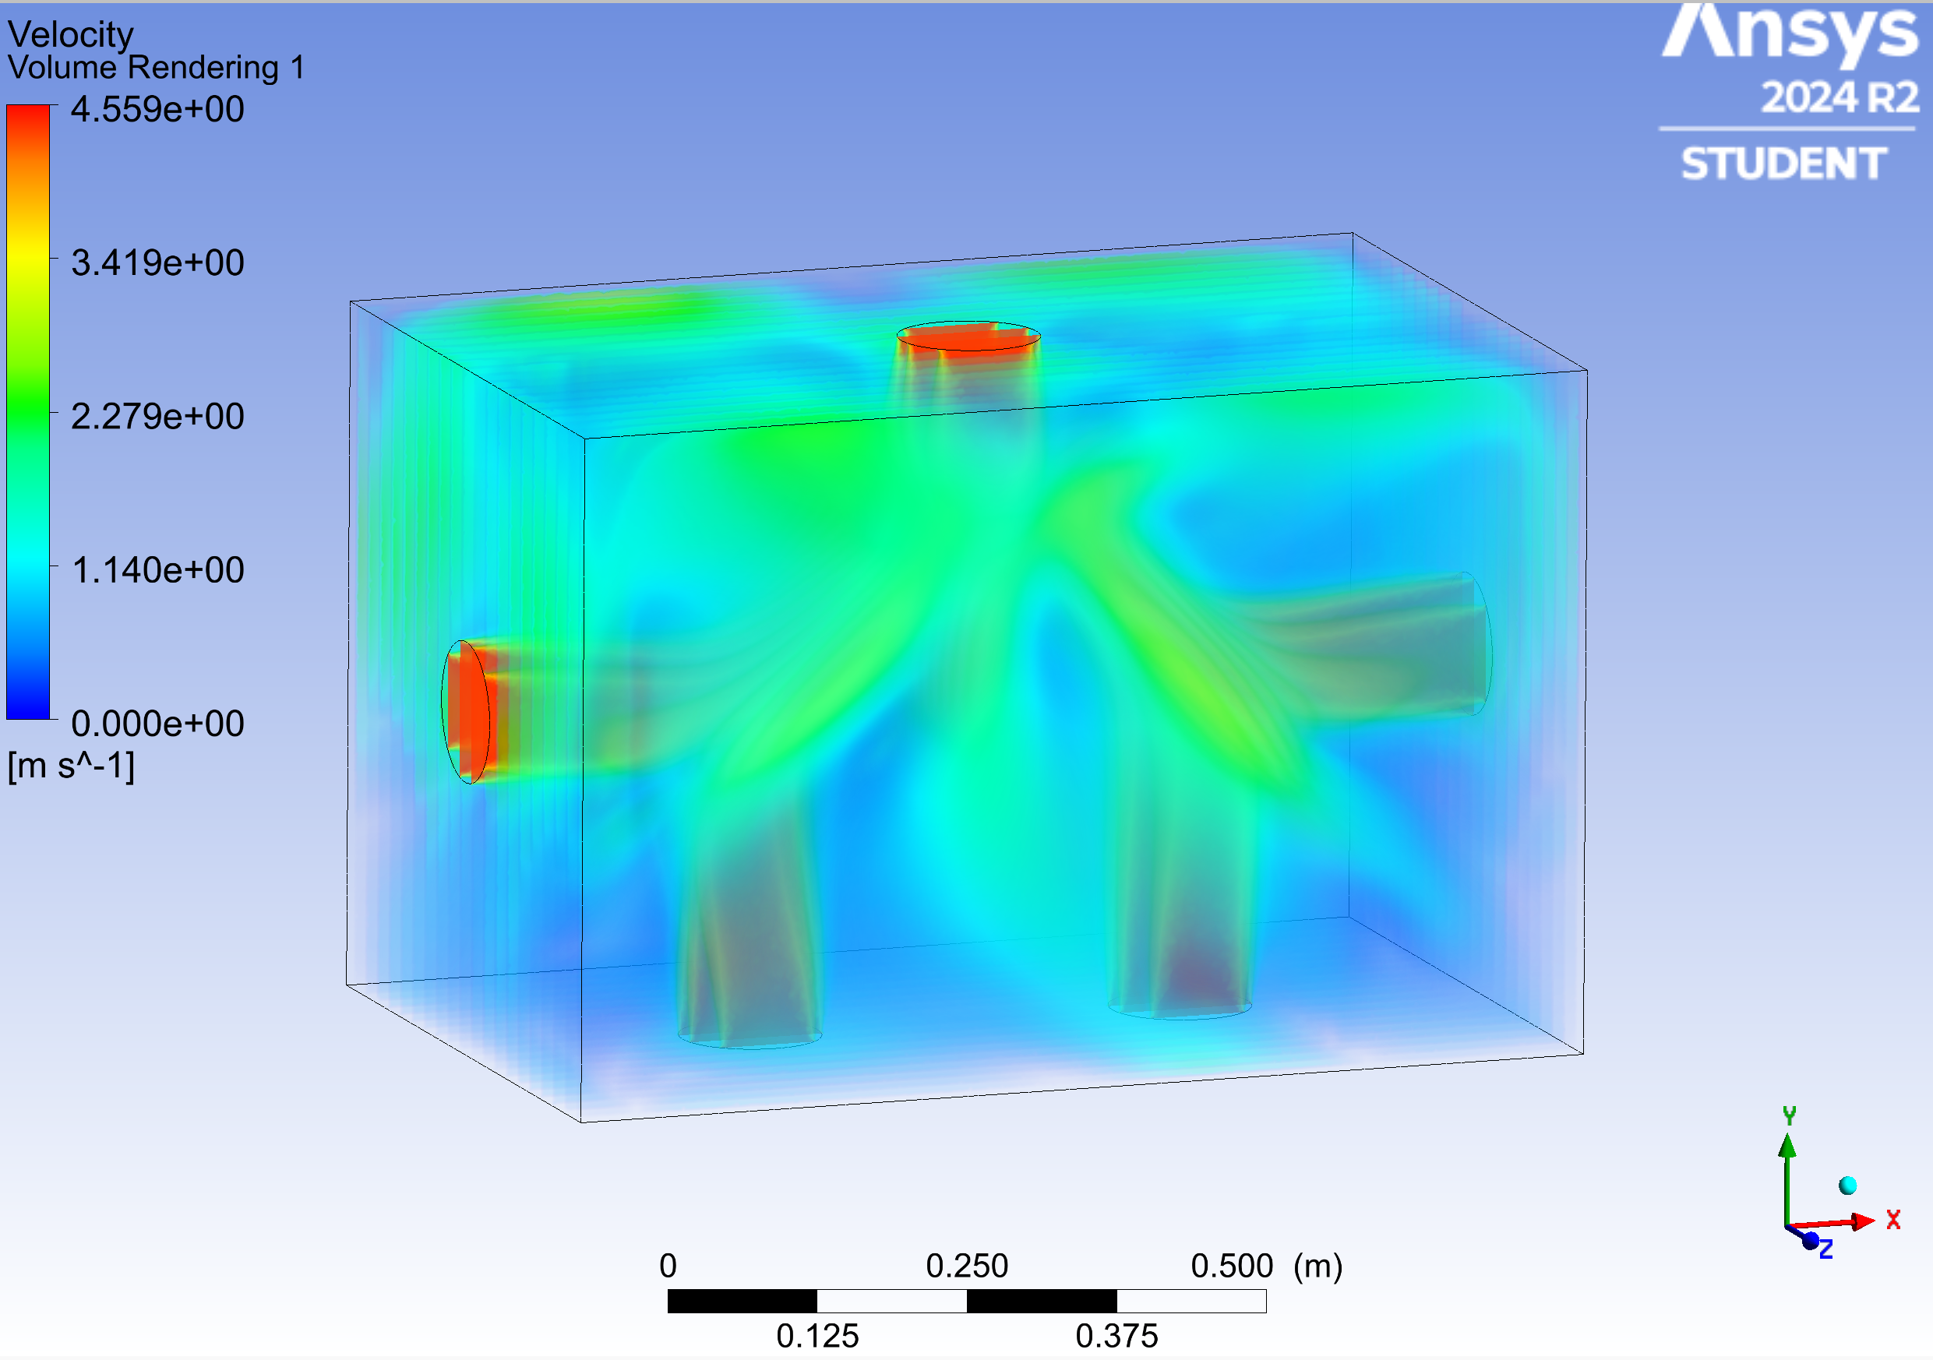
Preliminary Fan Position: Starfish - Biomimicry
Ryan Dreibelbis
Dead zone (low velocity region)
Notes:
Most recent iteration not final draft
Talk about four latches securing the main body top and four securing the funnel enclosure top
Maybe a possible rubber insert in the circle of the funnel portioning for the funnel stopper to push down
Main body 24 x 24 x 36 inches
Funnel enclosure 4 x 4 x 4 inches
Funnel built into box
Main body top and funnel enclosure top both completely removable
Both sandwiched with rubber gasket material
8 latches total
Funnel insert from funnel enclosure top
Secure funnel stopper

Slide 14
CFD Iterations: Assumptions and Simplifications
Ryan Dreibelbis
Flow
Fans
Microparticles
Steady flow
Multiphase flow
Air and simulant particles
Modeled as velocity inlets
No mass inflow/outflow
Does not account for fan mount
Perfectly spherical
Uniformly distributed diameters
Initially settled, equally spaced on glovebox floor
25°C

Slide 15
CFD Iterations: Major Challenges
Ryan Dreibelbis
Challenge 1:
Challenge 2:
Challenge 3:
Achieving a convergent (accurate) solution
Longer solver run times
Overworking/overheating hardware due to long run times
Mesh size and software limitations
Different fan configurations converge differently
Increased mesh size and iterations for a steady state model
Transient simulation not feasible
Excessive run times/sequential runs overwork hardware

Slide 16
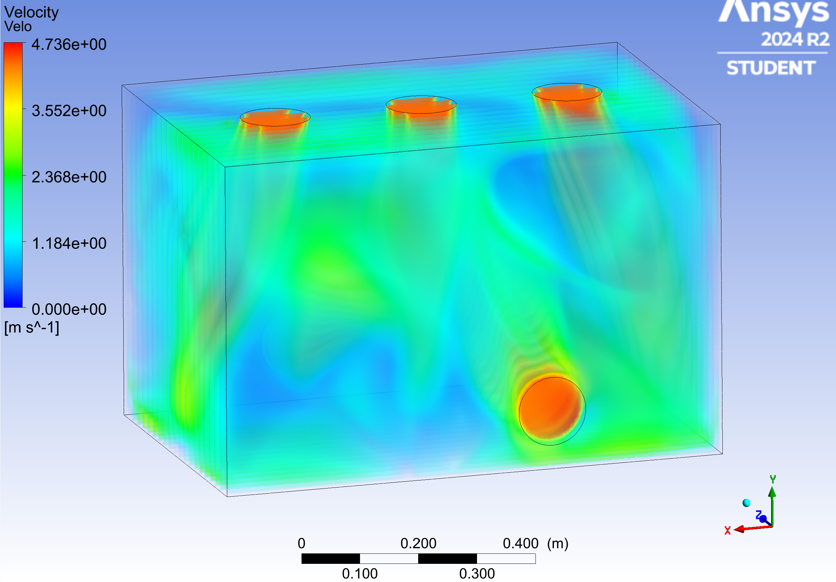
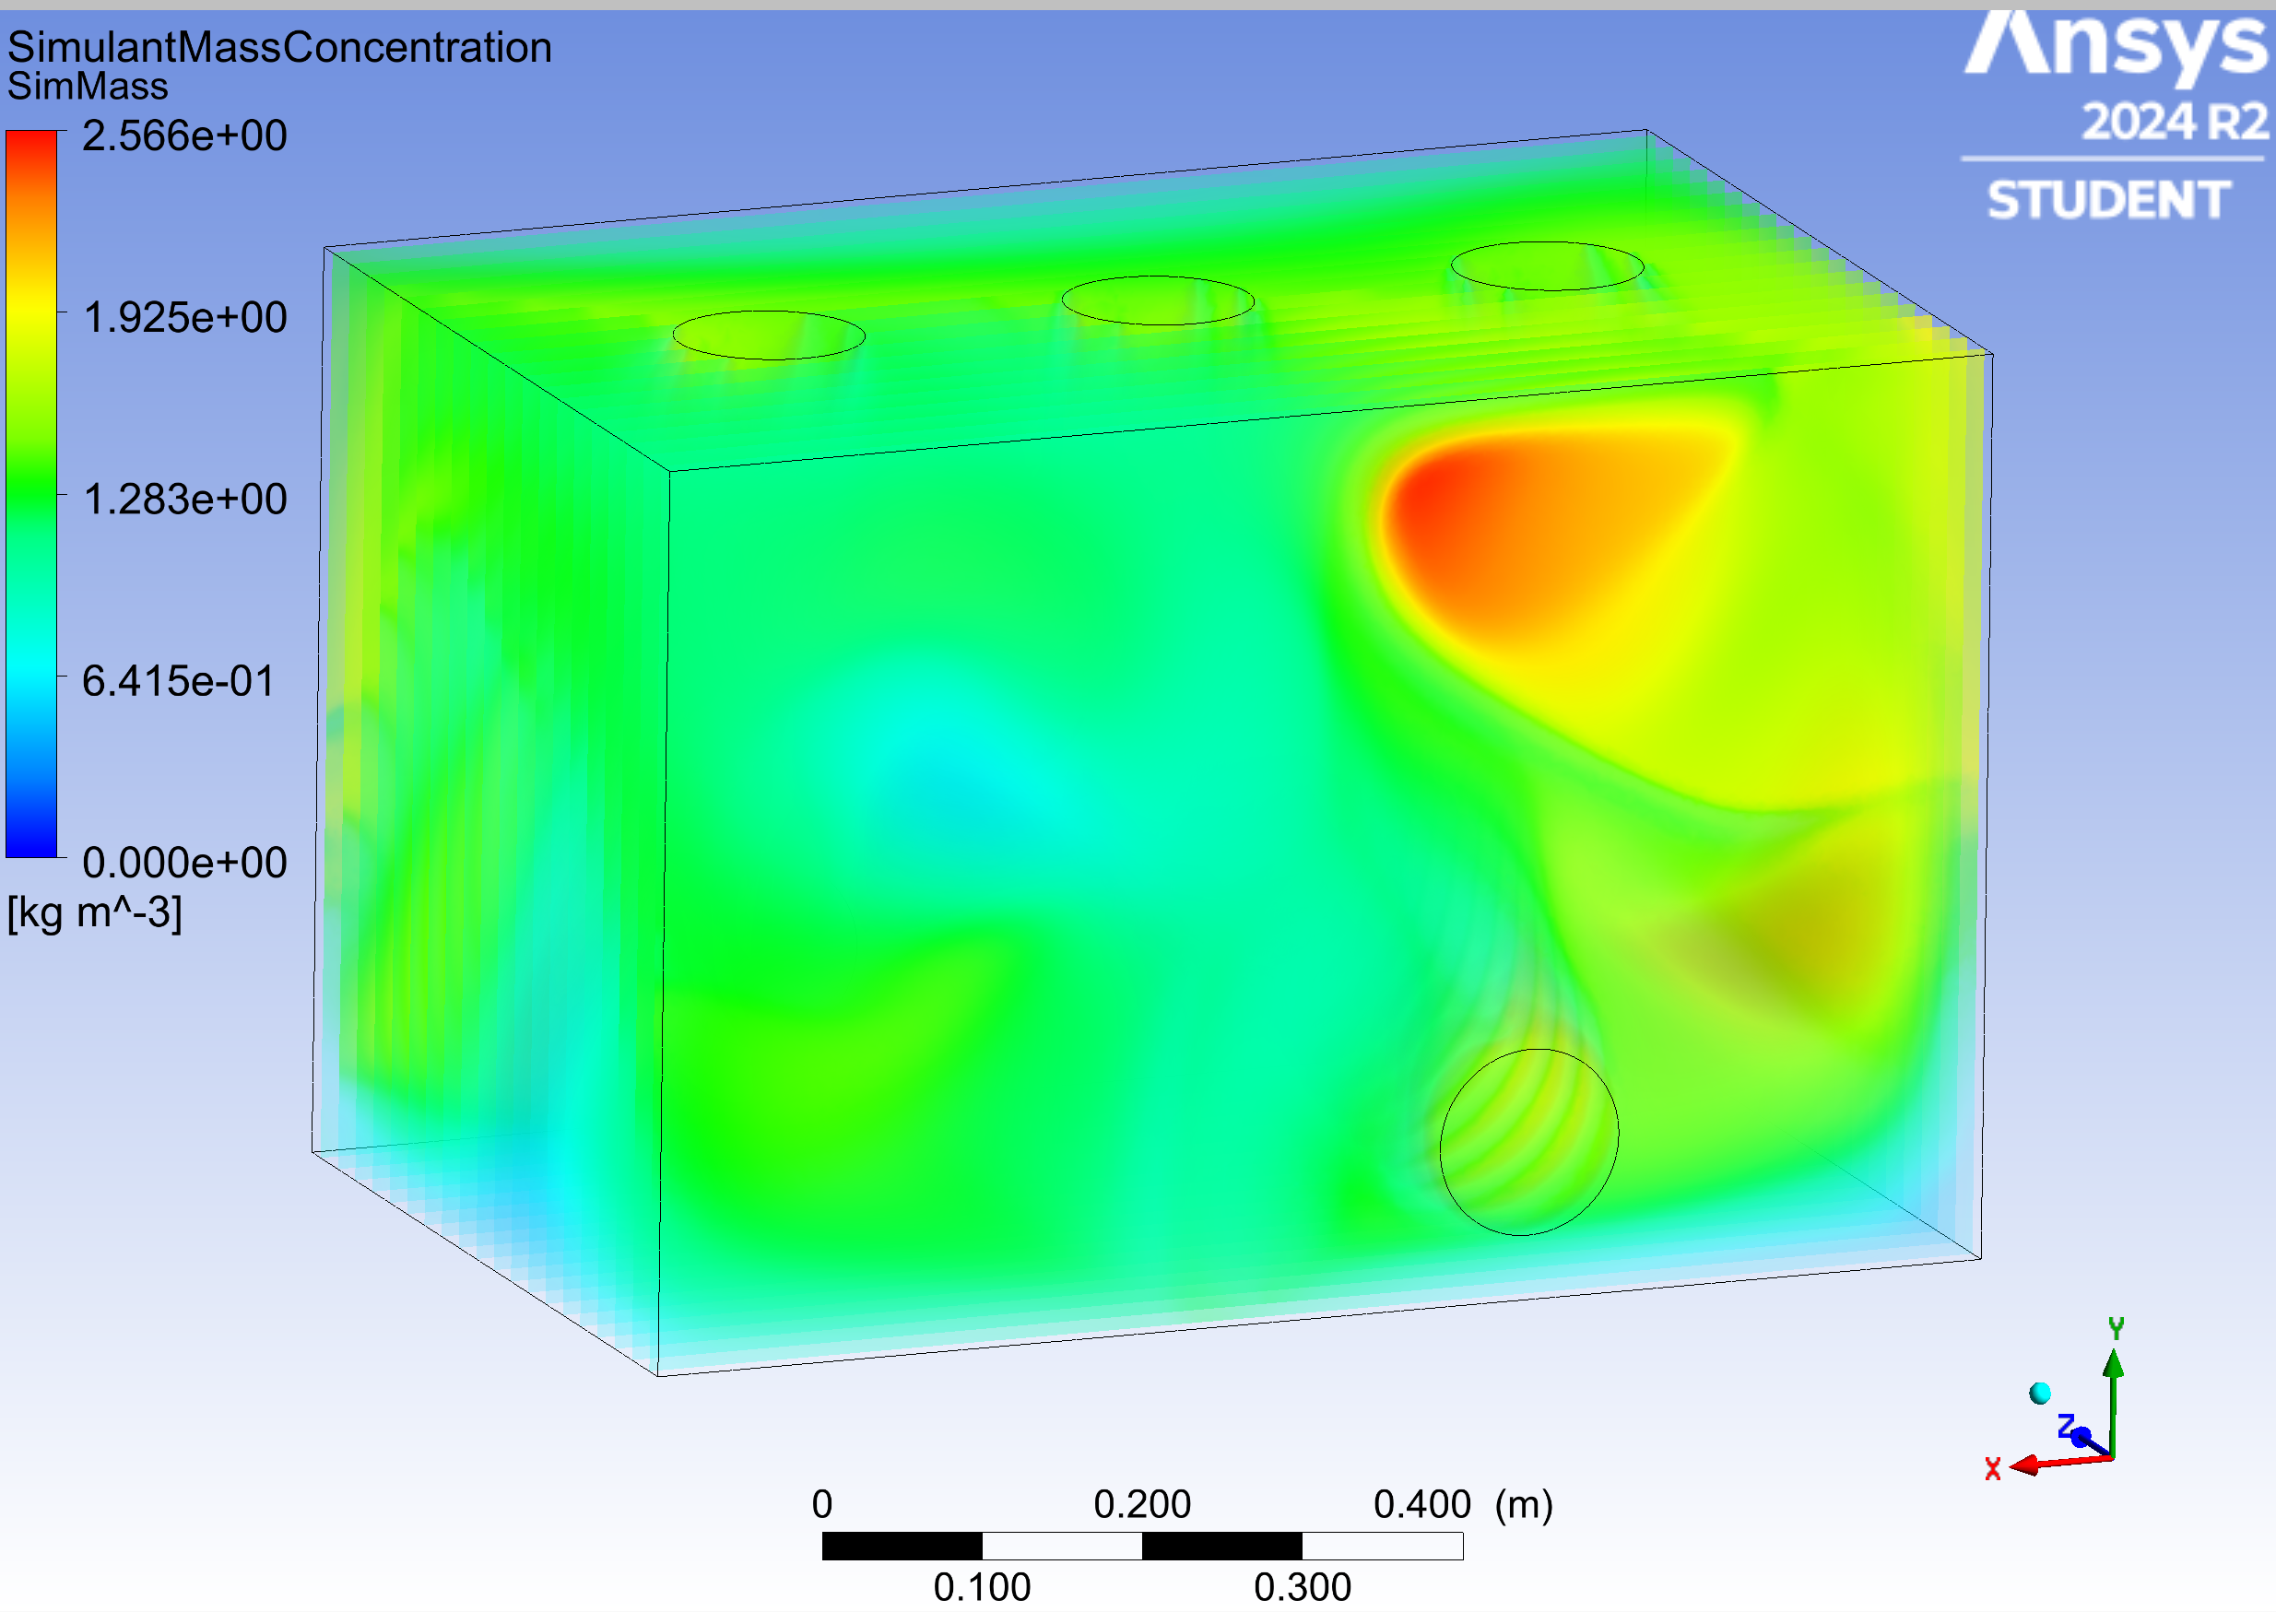
CFD Iterations: First Final Run: Fan Position 8
Lawrence Terrell
Dead zone
Velocity Plot
Mass Concentration Plot
Notes:
These images show the volume rendering for the simulant mass concentration inside the glove box. The results displayed are still for our secondary fan position design where the fans mounted on the side walls are shifted to the right. Volume rendering is a very useful tool in showing the mass concentration for the simulant in the corners, which are areas of concern for our sponsors since that is where the simulant would usually build up in from their previous design. Based on the shown volume rendering, our secondary fan position does not let the simulant build up in the corners of the glove box, but still builds up slightly towards the edges of the glove box.

Slide 17
CFD Iterations: First Final Run: Fan Position 8
Lawrence Terrell
Fan Position 8: Velocity Contour Sweep Animation
Notes:
This animation shows the velocity contour throughout the glove box with the second fan position design. In this design the side fans are shifted 6 inches to the right of the center of the side wall, facing perpendicular to the side wall. The velocity contours provide a way to check that the airflow in the simulation is reasonable and thus the simulation was executed properly. The sweep animation can also be utilized to show the simulant mass concentration inside the glove box.

Slide 18
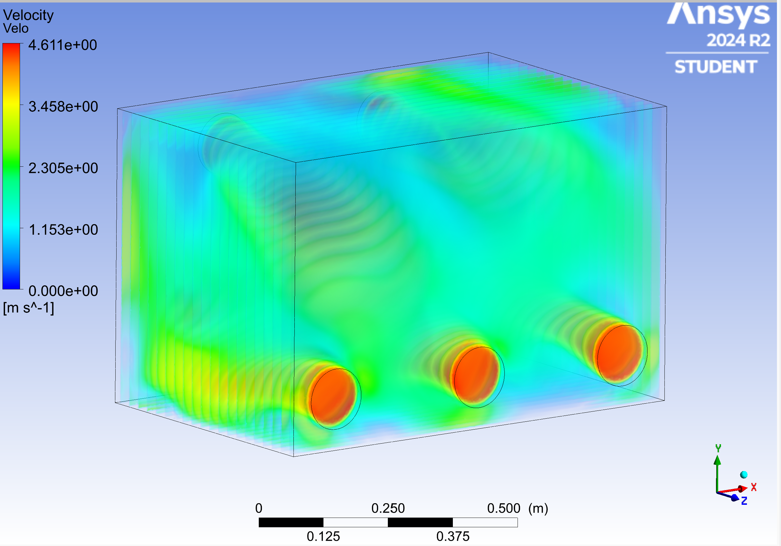
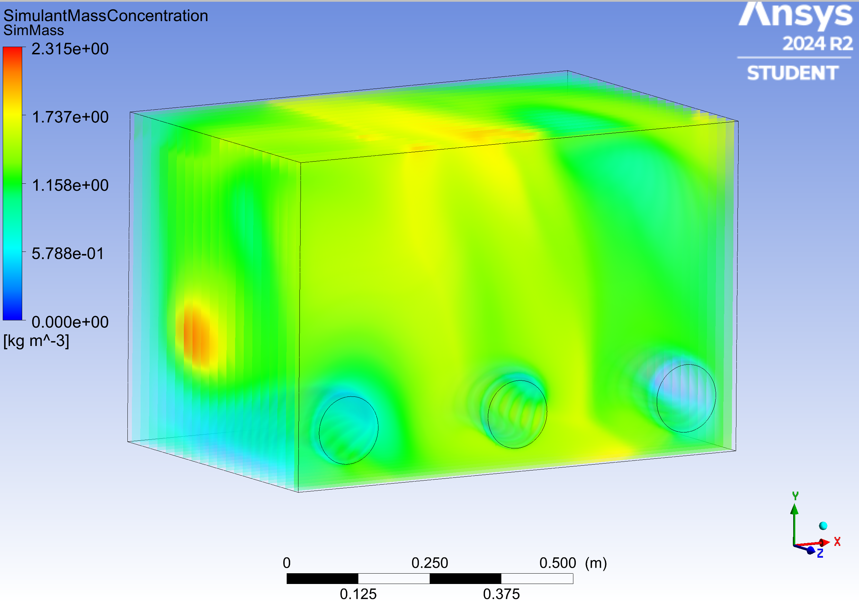
CFD Iterations: Second Final Run: Fan Position 7 Angle 1
Lawrence Terrell
Velocity Gradient
Mass Concentration Gradient
Notes:
These images show the volume rendering for the simulant mass concentration inside the glove box. The results displayed are still for our secondary fan position design where the fans mounted on the side walls are shifted to the right. Volume rendering is a very useful tool in showing the mass concentration for the simulant in the corners, which are areas of concern for our sponsors since that is where the simulant would usually build up in from their previous design. Based on the shown volume rendering, our secondary fan position does not let the simulant build up in the corners of the glove box, but still builds up slightly towards the edges of the glove box.

Slide 19
CFD Iterations: Second Final Run: Fan Position 7 Angle 1
Lawrence Terrell
Fan Position 7 Angle 1: Velocity Contour Sweep Animation
Notes:
These images show the volume rendering for the simulant mass concentration inside the glove box. The results displayed are still for our secondary fan position design where the fans mounted on the side walls are shifted to the right. Volume rendering is a very useful tool in showing the mass concentration for the simulant in the corners, which are areas of concern for our sponsors since that is where the simulant would usually build up in from their previous design. Based on the shown volume rendering, our secondary fan position does not let the simulant build up in the corners of the glove box, but still builds up slightly towards the edges of the glove box.

Slide 20
Final Design: CAD Assembled Glovebox
Nia Britton
Notes:
Now well be Moving on to the Finalized design of the glovebox. Besides the polycarbonate sheets, the glovebox has 11 unique parts, including the parts to compress the gasket, the set up for the fans, and the vacuum valve set up. The main dimensions of the enclosure are 3 by 2 by 2 feet.

Slide 21
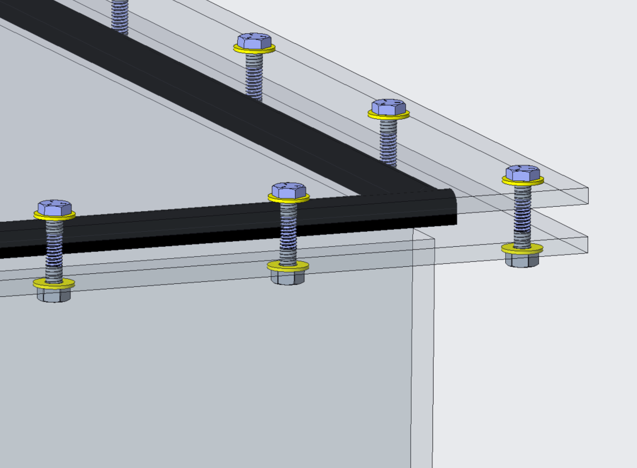
Final Design: Gasket “Sandwich”
Nia Britton
Compressed weather-resistant rubber seal
Seals off outer atmosphere
Secures inner continents
Washers to help with load distribution and prevent damage
Same design mimicked for funnel enclosure
Notes:
Moving into the specifics of the design, this slide showcases the final gasket 'sandwich' design for our enclosure. the use of a compressed weather-resistant rubber seal is critical for sealing off the outer atmosphere, and ensuring that the internal environment remains protected and secure. As the name suggests, there is layered construction – the rubber gasket is compressed between two layers using bolts and washers. These washers are particularly important, as they help distribute the load evenly and prevent damage to the enclosure materials over time. This configuration ensures that the inner contents remain secure and is mimicked in the funnel enclosure system for consistency.

Slide 22
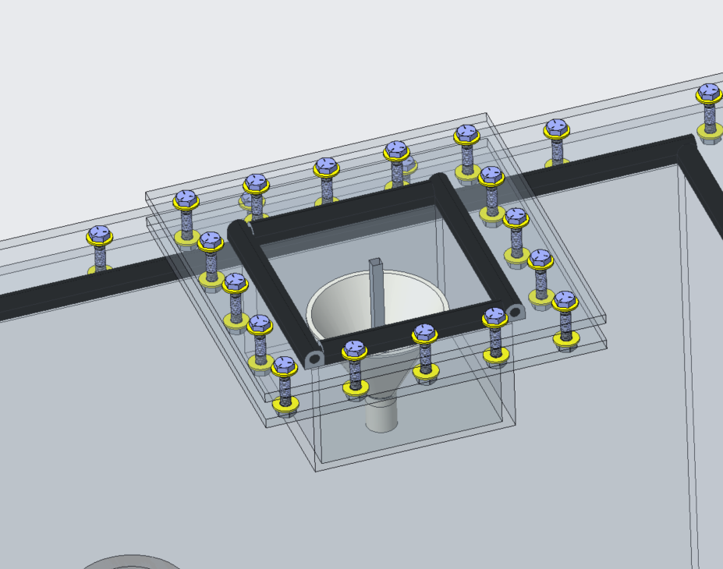
Final Design: Funnel Enclosure
Nia Britton
Funnel stoper built into top
Attached funnel used to guide simulant
Glued into entry point
0.75 inch diameter spout
Leftover gasket as funnel-to-funnel-stopper barrier
Notes:
Next, we’ll take a closer look at the final design for the funnel enclosure. Built into the roof of the funnel enclosure, a funnel stopper has been designed to keep simulant in during testing. The funnel is glued into the entry point, which has a 0.75-inch diameter spout, and will help our team guide the simulant into the testing enclosure. We also plan to repurpose leftover gasket material from the main chamber seal to act as a barrier between the funnel and the stopper. This approach will not only help us keep simulant from being introduced back into the enclosure during the runs, but is also good for sustainability.

Slide 23
Final Design: Faucet Valve
Nia Britton
Pipe fitting connected to faucet valve
For vacuum testing to ensure airtight seal
Can retest in between run for safety and security
Notes:
Here we have the faucet valve component of our design, located near the base of the glovebox. This valve is connected to a pipe fitting and will be used for the pre-run vacuum testing Mina spoke about earlier. The purpose here is to test and verify that the enclosure maintains an airtight seal before and after runs. By integrating this faucet valve, we allow for repeated testing between experimental runs, and this entry point can easily be closed off during the runs.

Slide 24
Final Design: Fan Wire Exit Points
Nia Britton
Diameter accounts for fan wire and tolerance
External height additions used for wiring under box
Holes will be sealed and secured prior to test run
Enough wiring within to change fan positions easily
Notes:
Here, we highlight the designated exit points for the fan wires. Each hole is sized to account for both the fan wire diameter and some tolerance. To accommodate wiring underneath the box, we will used external height additions such as wooden blocks. Before any test runs, all wire exit holes will be sealed and secured to maintain the glovebox integrity. Additionally, we've incorporated enough slack in the internal wiring length to allow for easy repositioning of the fans as needed. This gives us both flexibility and functionality while maintaining a secure, controlled environment.

Slide 25
Design Iterations: Fan Mounts
Peter Mougey
Notes:
Here is a final draft of the glovebox design we want the machine shop to craft for us, with a spot for vacuum testing, a main box enclosure, a funnel enclosure, and latches to secure the tops
Taalk about four latches securing the main body top and four securing the funnel enclosure top
Maybe a possible rubber insert in the circle of the funnel portiong for the funnel stopper to push down
Main body 24 x 24 x 36 inches
Funnel enclosure 4 x 4 x 4 inches
Funnel built into box
Main body top and funnel enclosure top both completely removable
Both sandwiched with rubber gasket material
8 latches total
Funnel insert from funnel enclosure top
Secure funnel stopper

Slide 26
Design Iterations: Fan Mounts: Suction Cups
Peter Mougey
Side View
Top View
Heavy Duty Suction Cups
Glovebox Wall
Lexan polycarbonate
0.25 inch thick
Notes:
Here is a final draft of the glovebox design we want the machine shop to craft for us, with a spot for vacuum testing, a main box enclosure, a funnel enclosure, and latches to secure the tops
Taalk about four latches securing the main body top and four securing the funnel enclosure top
Maybe a possible rubber insert in the circle of the funnel portiong for the funnel stopper to push down
Main body 24 x 24 x 36 inches
Funnel enclosure 4 x 4 x 4 inches
Funnel built into box
Main body top and funnel enclosure top both completely removable
Both sandwiched with rubber gasket material
8 latches total
Funnel insert from funnel enclosure top
Secure funnel stopper

Slide 27
Design Iterations: Fan Mounts: Attachment
Peter Mougey
Notes:
Here is a final draft of the glovebox design we want the machine shop to craft for us, with a spot for vacuum testing, a main box enclosure, a funnel enclosure, and latches to secure the tops
Taalk about four latches securing the main body top and four securing the funnel enclosure top
Maybe a possible rubber insert in the circle of the funnel portiong for the funnel stopper to push down
Main body 24 x 24 x 36 inches
Funnel enclosure 4 x 4 x 4 inches
Funnel built into box
Main body top and funnel enclosure top both completely removable
Both sandwiched with rubber gasket material
8 latches total
Funnel insert from funnel enclosure top
Secure funnel stopper

Slide 28
Design Iterations: Fan Mounts: Assembly
Peter Mougey
Notes:
Here is a final draft of the glovebox design we want the machine shop to craft for us, with a spot for vacuum testing, a main box enclosure, a funnel enclosure, and latches to secure the tops
Taalk about four latches securing the main body top and four securing the funnel enclosure top
Maybe a possible rubber insert in the circle of the funnel portiong for the funnel stopper to push down
Main body 24 x 24 x 36 inches
Funnel enclosure 4 x 4 x 4 inches
Funnel built into box
Main body top and funnel enclosure top both completely removable
Both sandwiched with rubber gasket material
8 latches total
Funnel insert from funnel enclosure top
Secure funnel stopper

Slide 29
Design Iterations: Fan Mounts: Pivot Joint
Peter Mougey
Notes:
Here is a final draft of the glovebox design we want the machine shop to craft for us, with a spot for vacuum testing, a main box enclosure, a funnel enclosure, and latches to secure the tops
Taalk about four latches securing the main body top and four securing the funnel enclosure top
Maybe a possible rubber insert in the circle of the funnel portiong for the funnel stopper to push down
Main body 24 x 24 x 36 inches
Funnel enclosure 4 x 4 x 4 inches
Funnel built into box
Main body top and funnel enclosure top both completely removable
Both sandwiched with rubber gasket material
8 latches total
Funnel insert from funnel enclosure top
Secure funnel stopper

Slide 30
Design Iterations: Fan Mounts: Pivot Joint
Peter Mougey
Notes:
Here is a final draft of the glovebox design we want the machine shop to craft for us, with a spot for vacuum testing, a main box enclosure, a funnel enclosure, and latches to secure the tops
Taalk about four latches securing the main body top and four securing the funnel enclosure top
Maybe a possible rubber insert in the circle of the funnel portiong for the funnel stopper to push down
Main body 24 x 24 x 36 inches
Funnel enclosure 4 x 4 x 4 inches
Funnel built into box
Main body top and funnel enclosure top both completely removable
Both sandwiched with rubber gasket material
8 latches total
Funnel insert from funnel enclosure top
Secure funnel stopper

Slide 31
Design Iterations: Fan Mounts: Pivot Joint
Peter Mougey
Notes:
Here is a final draft of the glovebox design we want the machine shop to craft for us, with a spot for vacuum testing, a main box enclosure, a funnel enclosure, and latches to secure the tops
Taalk about four latches securing the main body top and four securing the funnel enclosure top
Maybe a possible rubber insert in the circle of the funnel portiong for the funnel stopper to push down
Main body 24 x 24 x 36 inches
Funnel enclosure 4 x 4 x 4 inches
Funnel built into box
Main body top and funnel enclosure top both completely removable
Both sandwiched with rubber gasket material
8 latches total
Funnel insert from funnel enclosure top
Secure funnel stopper

Slide 32
Design Iterations: Fan Mounts: Pivot Joint
Peter Mougey
Notes:
Here is a final draft of the glovebox design we want the machine shop to craft for us, with a spot for vacuum testing, a main box enclosure, a funnel enclosure, and latches to secure the tops
Taalk about four latches securing the main body top and four securing the funnel enclosure top
Maybe a possible rubber insert in the circle of the funnel portiong for the funnel stopper to push down
Main body 24 x 24 x 36 inches
Funnel enclosure 4 x 4 x 4 inches
Funnel built into box
Main body top and funnel enclosure top both completely removable
Both sandwiched with rubber gasket material
8 latches total
Funnel insert from funnel enclosure top
Secure funnel stopper

Slide 33
Testing Details: Vacuum Testing
Mina Brahmbhatt
Vacuum Valve
Hose
Glovebox
Notes:
200 degrees celsius is empirical based on NASA research
Plans to bake first batch March 3rd – 4th
First test run March 4th
Dehydrating simulant in ovens
12 hours
200 degrees C
Safety​ ez
Goggles, lab coats, N95 masks, and gloves​
Placing box in fume hood​
Starting with dust settle​
Disposal and cleaning​
Wipe between runs​
Wet materials for safer disposal
The 12 hours and 200 degrees cel are empirical from nasa research. This is in order to get all the water from all the porous surfaces within the particles. 100 degrees will not dehydrate the simulant like we need it too, and the drying process we plan to use will only change the density by 1 percent
NASA looked at mass loss in the material and how much changes. 200 is just what they have been empirically able to show works. Higher than 200 would alter the materials in there. No clay on lunar surface bc no water on lunar surface. So ideally want simulants that don’t have clay bc bc theyre on earth theyre exposed to water so they have clay minerals exposed which is not ideal and we dont want them there but are still there no matter what we do. When we bake at higher temperatures, those clay minerals are first thing that start to change. When we bake it gets them to the version out that we dont want but not too much to where they alter. 200 is in between value that gets that water out and takes some of clay out but not too much to where it alters way too much. Lower wouldnt get all surface bound water out. Might be intraporous spaces filled with water that will come to surface, so want to bake it out. 100 degrees will not be sufficient to do that. Doesn't have to be exactly 12 hours, they sort of just do overnight sort of thing where they leave materials overnight in oven and let it bake itself out.
Can bake it out and do pre and post mass calculations and see how mass changes with 15 hours vs 12 butwont be super different.
Baking wont change bulk density a lot bc maybe 1% water in materials. If 10% water then ye sit would change it

Slide 34
Testing Details: Vacuum Testing
Mina Brahmbhatt
Glovebox
Notes:
200 degrees celsius is empirical based on NASA research
Plans to bake first batch March 3rd – 4th
First test run March 4th
Dehydrating simulant in ovens
12 hours
200 degrees C
Safety​ ez
Goggles, lab coats, N95 masks, and gloves​
Placing box in fume hood​
Starting with dust settle​
Disposal and cleaning​
Wipe between runs​
Wet materials for safer disposal
The 12 hours and 200 degrees cel are empirical from nasa research. This is in order to get all the water from all the porous surfaces within the particles. 100 degrees will not dehydrate the simulant like we need it too, and the drying process we plan to use will only change the density by 1 percent
NASA looked at mass loss in the material and how much changes. 200 is just what they have been empirically able to show works. Higher than 200 would alter the materials in there. No clay on lunar surface bc no water on lunar surface. So ideally want simulants that don’t have clay bc bc theyre on earth theyre exposed to water so they have clay minerals exposed which is not ideal and we dont want them there but are still there no matter what we do. When we bake at higher temperatures, those clay minerals are first thing that start to change. When we bake it gets them to the version out that we dont want but not too much to where they alter. 200 is in between value that gets that water out and takes some of clay out but not too much to where it alters way too much. Lower wouldnt get all surface bound water out. Might be intraporous spaces filled with water that will come to surface, so want to bake it out. 100 degrees will not be sufficient to do that. Doesn't have to be exactly 12 hours, they sort of just do overnight sort of thing where they leave materials overnight in oven and let it bake itself out.
Can bake it out and do pre and post mass calculations and see how mass changes with 15 hours vs 12 butwont be super different.
Baking wont change bulk density a lot bc maybe 1% water in materials. If 10% water then ye sit would change it

Slide 35
Testing Details: Vacuum Testing
Mina Brahmbhatt
Glovebox
Notes:
200 degrees celsius is empirical based on NASA research
Plans to bake first batch March 3rd – 4th
First test run March 4th
Dehydrating simulant in ovens
12 hours
200 degrees C
Safety​ ez
Goggles, lab coats, N95 masks, and gloves​
Placing box in fume hood​
Starting with dust settle​
Disposal and cleaning​
Wipe between runs​
Wet materials for safer disposal
The 12 hours and 200 degrees cel are empirical from nasa research. This is in order to get all the water from all the porous surfaces within the particles. 100 degrees will not dehydrate the simulant like we need it too, and the drying process we plan to use will only change the density by 1 percent
NASA looked at mass loss in the material and how much changes. 200 is just what they have been empirically able to show works. Higher than 200 would alter the materials in there. No clay on lunar surface bc no water on lunar surface. So ideally want simulants that don’t have clay bc bc theyre on earth theyre exposed to water so they have clay minerals exposed which is not ideal and we dont want them there but are still there no matter what we do. When we bake at higher temperatures, those clay minerals are first thing that start to change. When we bake it gets them to the version out that we dont want but not too much to where they alter. 200 is in between value that gets that water out and takes some of clay out but not too much to where it alters way too much. Lower wouldnt get all surface bound water out. Might be intraporous spaces filled with water that will come to surface, so want to bake it out. 100 degrees will not be sufficient to do that. Doesn't have to be exactly 12 hours, they sort of just do overnight sort of thing where they leave materials overnight in oven and let it bake itself out.
Can bake it out and do pre and post mass calculations and see how mass changes with 15 hours vs 12 butwont be super different.
Baking wont change bulk density a lot bc maybe 1% water in materials. If 10% water then ye sit would change it

Slide 36
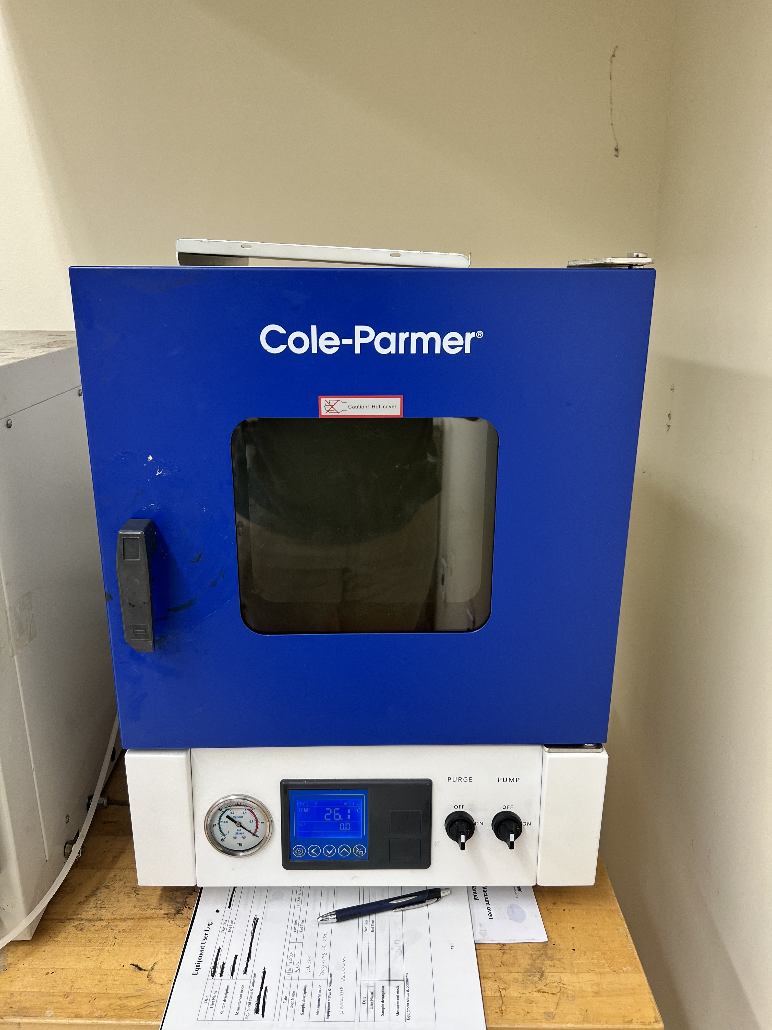
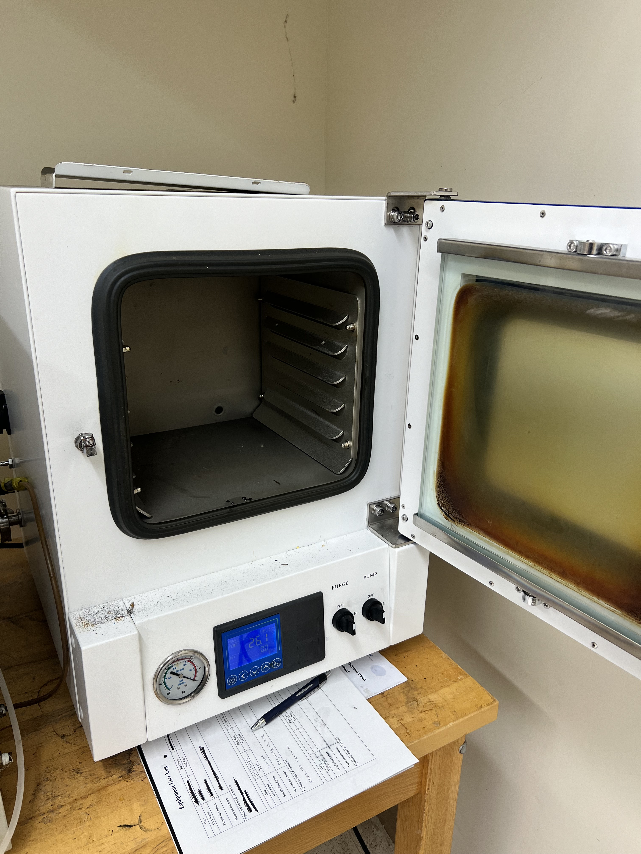
Experiment Details: Preparation
Mina Brahmbhatt
12 hours
200 $°$C
NASA research
Selected Ovens in Room 124 at HPMI
Notes:
200 degrees celsius is empirical based on NASA research
The 12 hours and 200 degrees cel are empirical from nasa research. This is in order to get all the water from all the porous surfaces within the particles. 100 degrees will not dehydrate the simulant like we need it too, and the drying process we plan to use will only change the density by 1 percent
NASA looked at mass loss in the material and how much changes. 200 is just what they have been empirically able to show works. Higher than 200 would alter the materials in there. No clay on lunar surface bc no water on lunar surface. So ideally want simulants that don’t have clay bc bc theyre on earth theyre exposed to water so they have clay minerals exposed which is not ideal and we dont want them there but are still there no matter what we do. When we bake at higher temperatures, those clay minerals are first thing that start to change. When we bake it gets them to the version out that we dont want but not too much to where they alter. 200 is in between value that gets that water out and takes some of clay out but not too much to where it alters way too much. Lower wouldnt get all surface bound water out. Might be intraporous spaces filled with water that will come to surface, so want to bake it out. 100 degrees will not be sufficient to do that. Doesn't have to be exactly 12 hours, they sort of just do overnight sort of thing where they leave materials overnight in oven and let it bake itself out.
Can bake it out and do pre and post mass calculations and see how mass changes with 15 hours vs 12 butwont be super different.
Baking wont change bulk density a lot bc maybe 1% water in materials. If 10% water then ye sit would change it

Slide 37
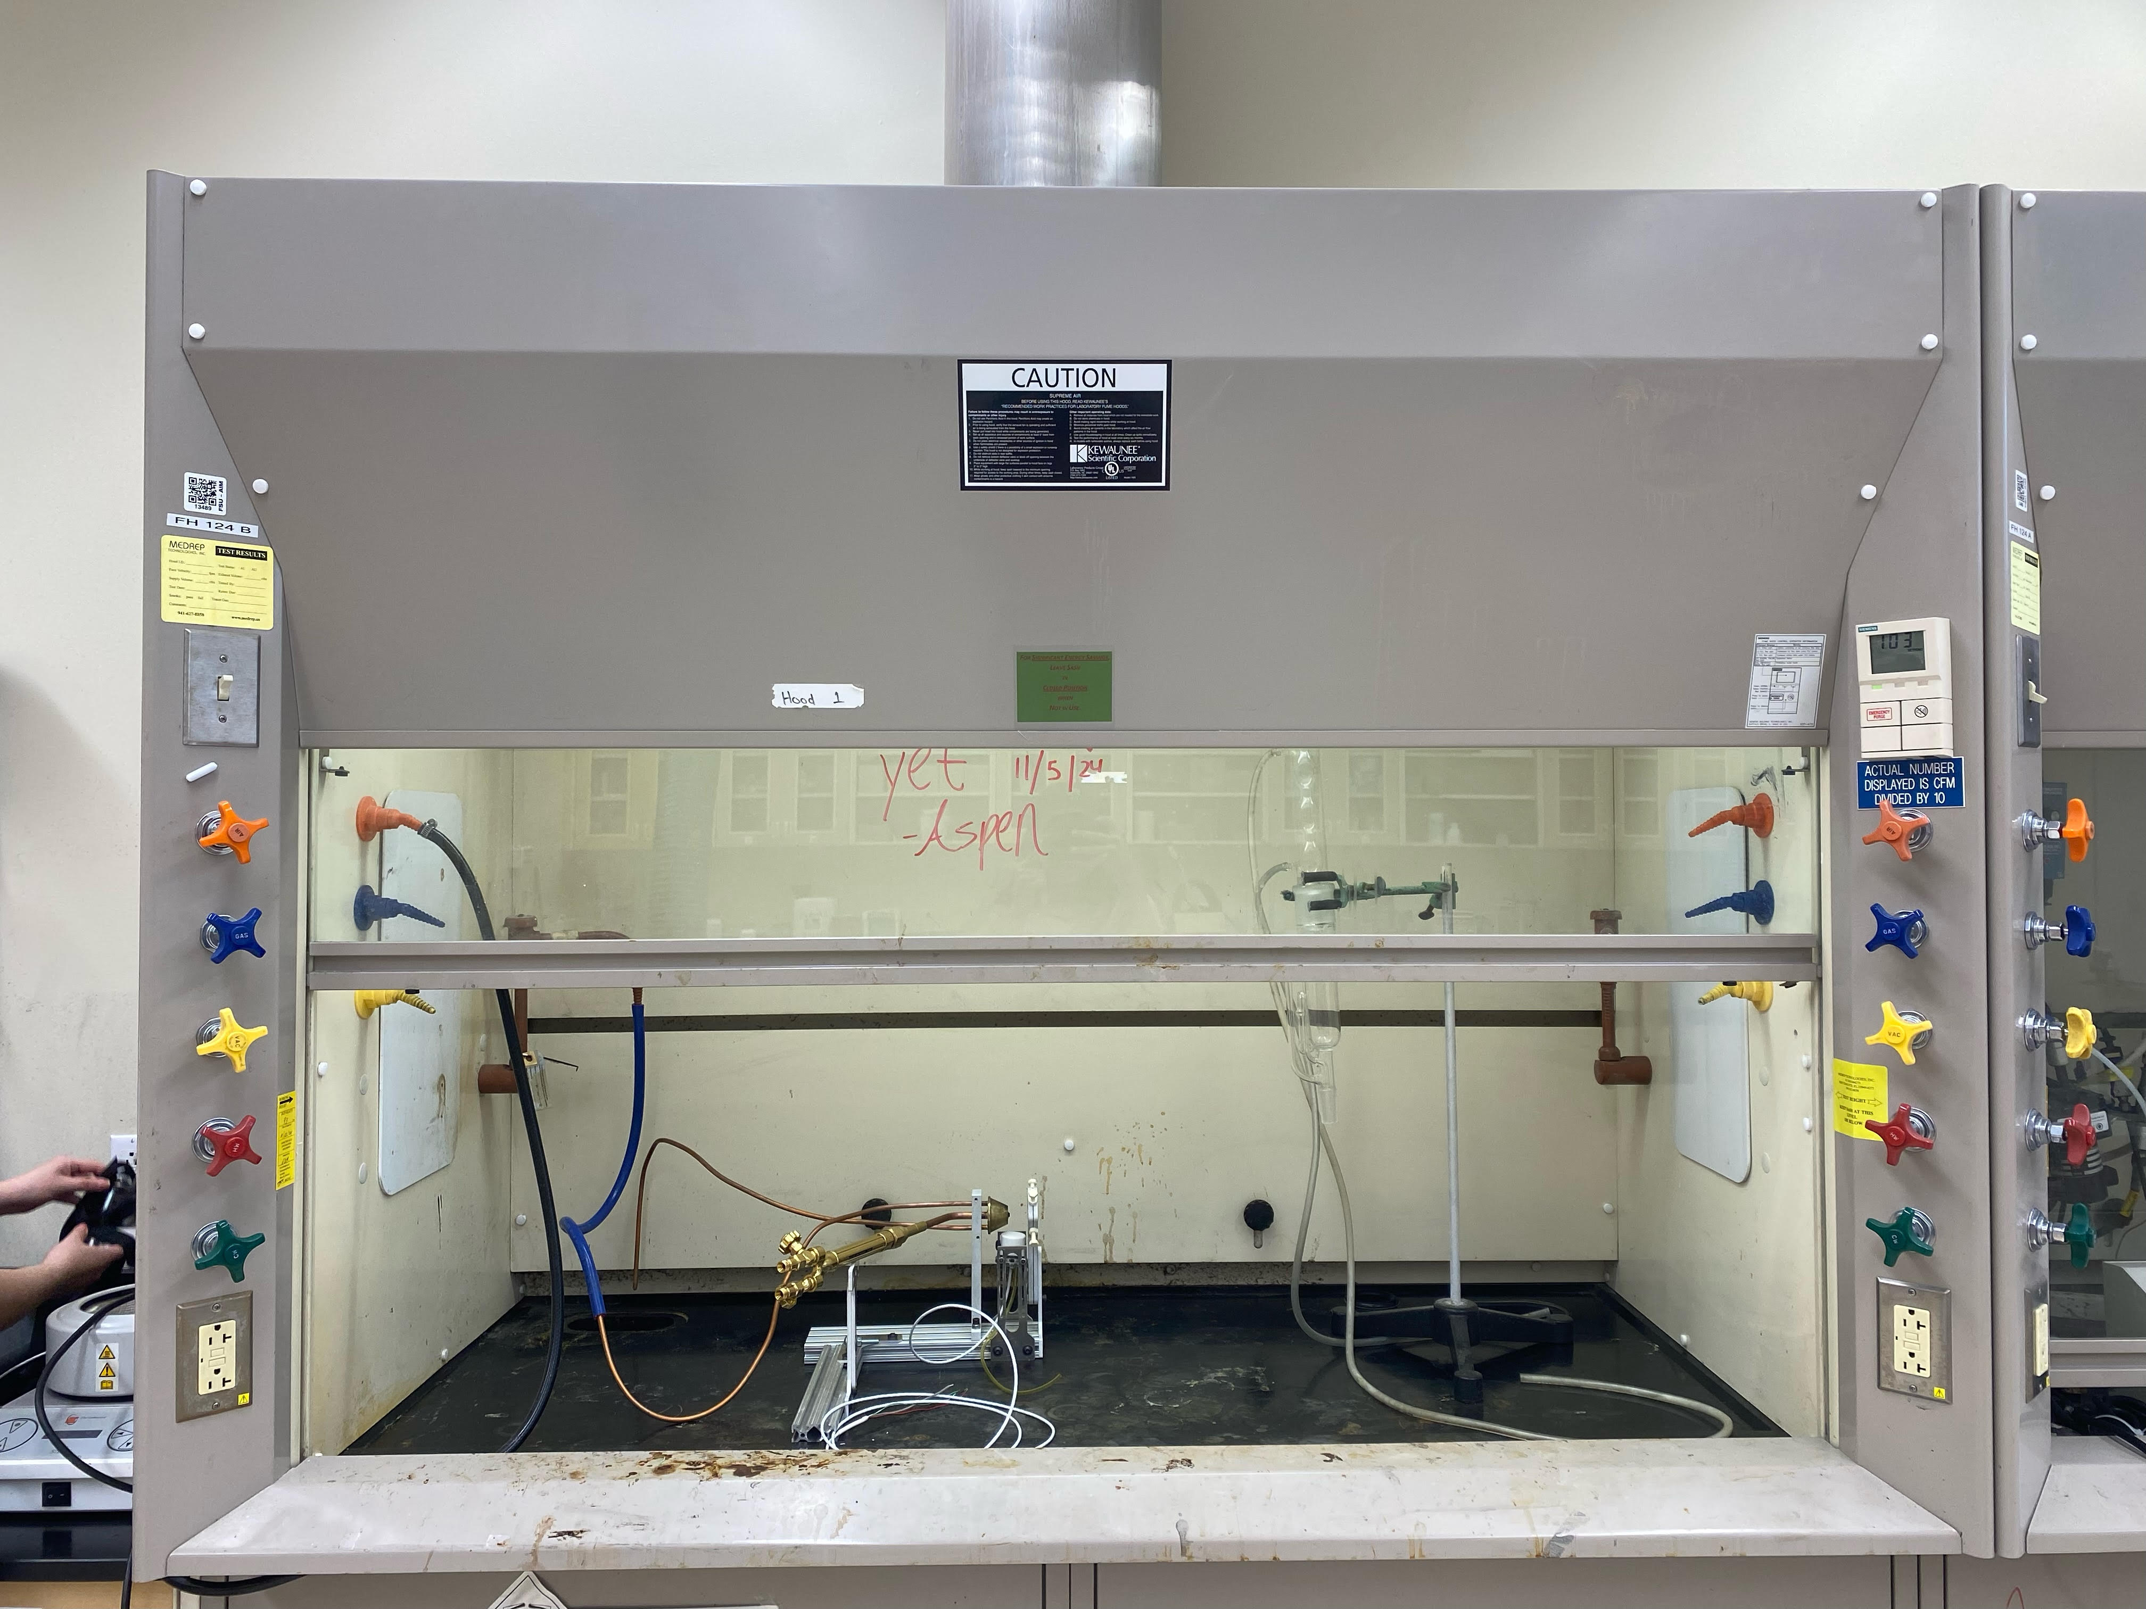
Testing Details: Preparation & Safety
Mina Brahmbhatt
Increased factor of safety
Capture and contain any escaped microparticles
Selected Fume hood in Room 124 at HPMI
Notes:
EXPLAIN WHY THESE DIMENSIONS ARE THE WAY THEY. ARE
200 degrees celsius is empirical based on NASA research
Can bake it out and do pre and post mass calculations and see how mass changes with 15 hours vs 12 butwont be super different.
Baking wont change bulk density a lot bc maybe 1% water in materials. If 10% water then ye sit would change it
Fumehood use
Reduce inhalation risks
Remove any aerosolized particles
Camera set up
Captures entire box
4.5 feet from box
iPhone raised 9 inches from ground
UV light set up
Left, outside facing inward
Fans set up
3 inch from wall
Adjustable angles
Controlled velocity

Slide 38
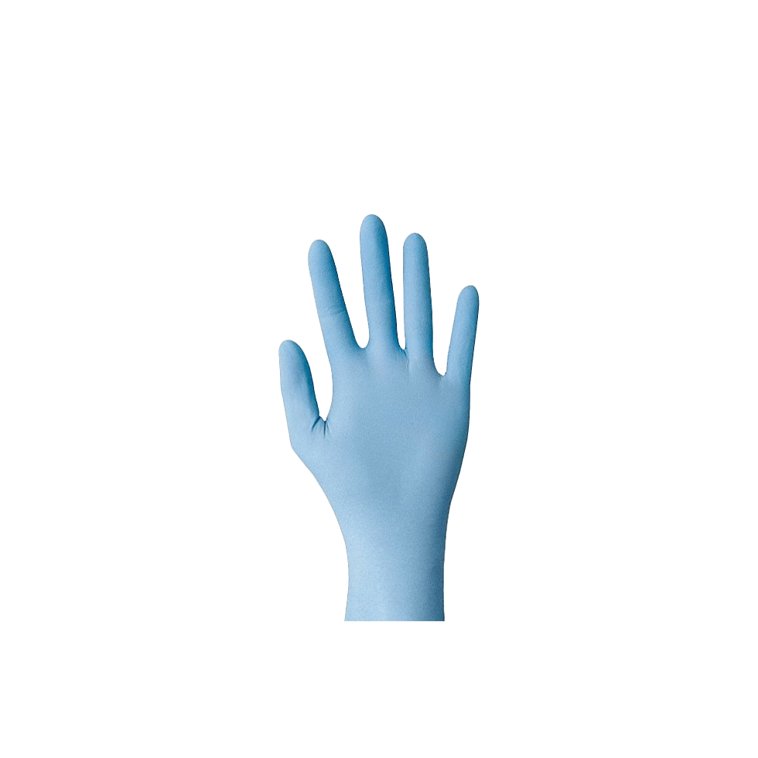
Testing Details: Preparation & Safety
Mina Brahmbhatt
Notes:
EXPLAIN WHY THESE DIMENSIONS ARE THE WAY THEY. ARE
200 degrees celsius is empirical based on NASA research
Can bake it out and do pre and post mass calculations and see how mass changes with 15 hours vs 12 butwont be super different.
Baking wont change bulk density a lot bc maybe 1% water in materials. If 10% water then ye sit would change it
Fumehood use
Reduce inhalation risks
Remove any aerosolized particles
Camera set up
Captures entire box
4.5 feet from box
iPhone raised 9 inches from ground
UV light set up
Left, outside facing inward
Fans set up
3 inch from wall
Adjustable angles
Controlled velocity

Slide 39
Testing Details: Preparation & Safety
Mina Brahmbhatt
Notes:
EXPLAIN WHY THESE DIMENSIONS ARE THE WAY THEY. ARE
200 degrees celsius is empirical based on NASA research
Can bake it out and do pre and post mass calculations and see how mass changes with 15 hours vs 12 butwont be super different.
Baking wont change bulk density a lot bc maybe 1% water in materials. If 10% water then ye sit would change it
Fumehood use
Reduce inhalation risks
Remove any aerosolized particles
Camera set up
Captures entire box
4.5 feet from box
iPhone raised 9 inches from ground
UV light set up
Left, outside facing inward
Fans set up
3 inch from wall
Adjustable angles
Controlled velocity

Slide 40
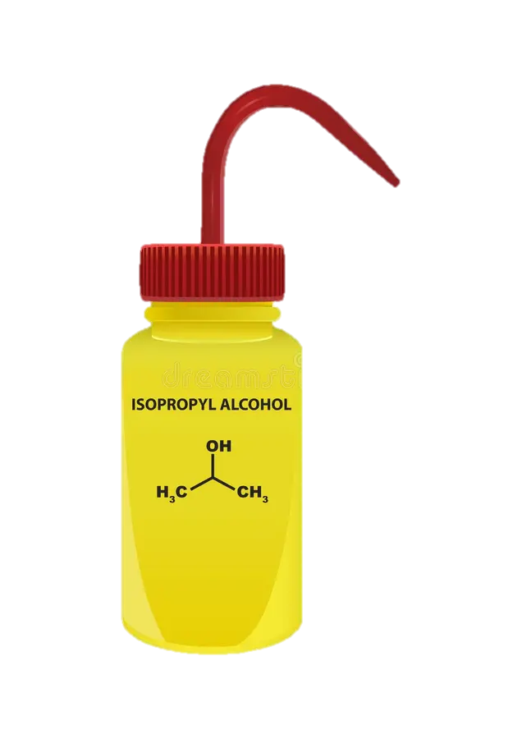
Experiment Details: Disposal & Cleaning
Mina Brahmbhatt
Notes:
200 degrees celsius is empirical based on NASA research
Plans to bake first batch March 3rd – 4th
First test run March 4th
Dehydrating simulant in ovens
12 hours
200 degrees C
Safety​ ez
Goggles, lab coats, N95 masks, and gloves​
Placing box in fume hood​
Starting with dust settle​
Disposal and cleaning​
Wipe between runs​
Wet materials for safer disposal
The 12 hours and 200 degrees cel are empirical from nasa research. This is in order to get all the water from all the porous surfaces within the particles. 100 degrees will not dehydrate the simulant like we need it too, and the drying process we plan to use will only change the density by 1 percent
NASA looked at mass loss in the material and how much changes. 200 is just what they have been empirically able to show works. Higher than 200 would alter the materials in there. No clay on lunar surface bc no water on lunar surface. So ideally want simulants that don’t have clay bc bc theyre on earth theyre exposed to water so they have clay minerals exposed which is not ideal and we dont want them there but are still there no matter what we do. When we bake at higher temperatures, those clay minerals are first thing that start to change. When we bake it gets them to the version out that we dont want but not too much to where they alter. 200 is in between value that gets that water out and takes some of clay out but not too much to where it alters way too much. Lower wouldnt get all surface bound water out. Might be intraporous spaces filled with water that will come to surface, so want to bake it out. 100 degrees will not be sufficient to do that. Doesn't have to be exactly 12 hours, they sort of just do overnight sort of thing where they leave materials overnight in oven and let it bake itself out.
Can bake it out and do pre and post mass calculations and see how mass changes with 15 hours vs 12 butwont be super different.
Baking wont change bulk density a lot bc maybe 1% water in materials. If 10% water then ye sit would change it

Slide 41
Testing Details: Visualization Challenge
Kendall Kovacs
Notes:
-explain that these are hard to see with the naked eye
-click next slide so they shrink

Slide 42
Testing Details: Visualization Challenge
Kendall Kovacs
Notes:
So in order to visualize how the lunar simulant is moving the glovebox, fluorescent beads and UV light will be used. (move to next slide)

Slide 43
Testing Details: Visualization Challenge
Kendall Kovacs
Notes:
So in order to visualize how the lunar simulant is moving the glovebox, fluorescent beads and UV light will be used. (move to next slide)

Slide 44
Testing Details: UV Light Visualization Solution
Kendall Kovacs

Slide 45
Testing Details: Microspheres vs. Simulant
Kendall Kovacs
Microsphere Density
Simulant Density

Slide 46
Testing Details: Microspheres vs. Simulant
Kendall Kovacs
Microsphere Density
Simulant Density

Slide 47
Testing Details: Microspheres vs. Simulant
Kendall Kovacs
Microsphere Settling Velocity
Simulant Settling Velocity
Larger particle size distribution
Smaller particle size distribution
Smaller density
Larger density

Slide 48
Project Background:
Microsphere vs. Simulant Ratio
Kendall Kovacs
1:100 microsphere to simulant ratio

Slide 49
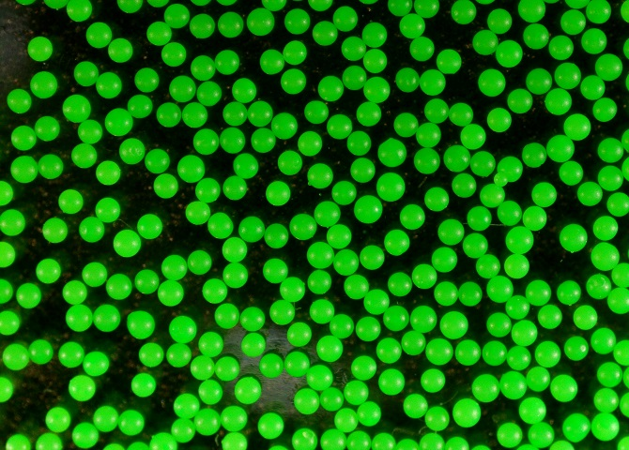
Project Background:
Microspheres
Kendall Kovacs
Polyethylene Green Fluorescent Microspheres

Slide 50
Testing Details: Front of Box Experimental Data
Kendall Kovacs
Double Sided Tape
At dead zone and high velocity locations from CFD

Slide 51
Testing Details: Front of Box Experimental Data
Kendall Kovacs

Slide 52
Testing Details: Front of Box Experimental Data
Kendall Kovacs
Photos of Tape
Before simulant enters
T = 0 seconds
T = 15 seconds
T = 1 minute
T = 2 minutes
T = 3 minutes
T = 4 minutes
T = 5 minutes
After fans turn off and simulant settled on bottom
Notes:
Scotch Double Sided tape 13x13 mm on places with high mass concentrations, dead zoens, and some middle. The pieces on the front will be photographed throughout and the pieces on sides and back will just be post processing

Slide 53
Testing Details: Back of Box Post-Experimental Data
Kendall Kovacs
Double Sided Tape
3x5 array on back
3x3 array on each side
Photos taken post-trial

Slide 54
Testing Details: Post-Experimental Data
Kendall Kovacs
Dino-Lite Digital Microscope
Take photos of tape pieces on all four sides post-trial
ImageJ
Determine number of particles
Compare amount of simulant to amount of microspheres

Slide 55
Testing Details: Image Analysis and Validation
Kendall Kovacs
UV Light Photos
Microscope Photos
During experiment
Specific locations on front
Time-changing particle accumulation
CFD comparison
Post-experiment
Sides and back
Determine even distribution
Evenly dispersed
Notes:
If the quantity of fluorescent beads in each section of the box are similar then the lunar simulant can be considered evenly distributed.

Slide 56
Testing Details: Pre-Testing Verifications
Kendall Kovacs
Photos of Tape
Experimented with cinnamon
Notes:
EXPLAIN WHY THESE DIMENSIONS ARE THE WAY THEY. ARE
200 degrees celsius is empirical based on NASA research
Can bake it out and do pre and post mass calculations and see how mass changes with 15 hours vs 12 butwont be super different.
Baking wont change bulk density a lot bc maybe 1% water in materials. If 10% water then ye sit would change it
Fumehood use
Reduce inhalation risks
Remove any aerosolized particles
Camera set up
Captures entire box
4.5 feet from box
iPhone raised 9 inches from ground
UV light set up
Left, outside facing inward
Fans set up
3 inch from wall
Adjustable angles
Controlled velocity

Slide 57
Future Work
Nia Britton
Project poster completion and presentation planning
First run analysis
Second run analysis
First experimental run
Second experimental run
Complete project write up
Notes:
Here are some future steps we’ve planned to complete the project. First, we’ll conduct our initial experimental run, followed by a detailed analysis of that data. Based on what we find, we’ll make any necessary adjustments and then proceed with a second experimental run. After the second run, we’ll carry out another round of analysis to compare results and evaluate consistency.
Once testing and data collection are complete, we’ll finalize the project with a thorough write-up.Then, we’ll shift our focus toward completing the project poster and preparing for the final presentation

Slide 58
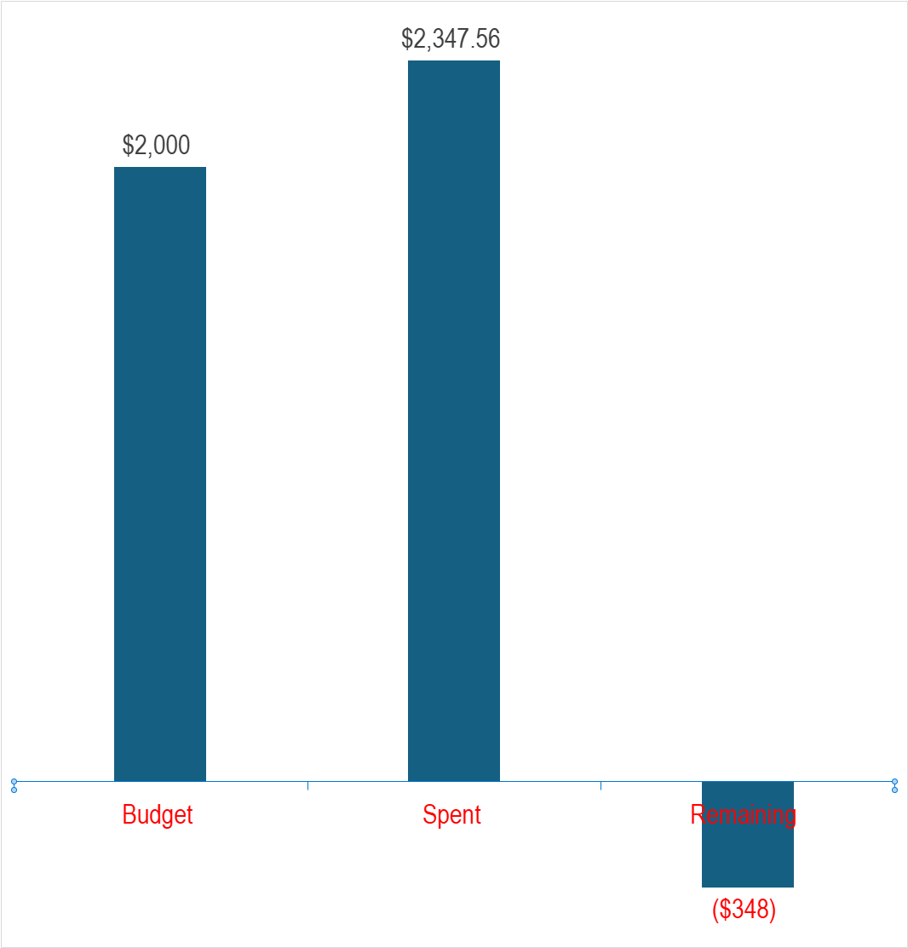
Budget: Financial Balance
Nia Britton
2000 USD allocated
117% of budget used
Notes:
We originally were allotted 2000 dollars for a budget, and in the end we ended up exceeding the budge by 17 percent.

Slide 59
Lessons Learned: CFD Team
Lawrence Terrell
There is not always a working solution available. Some projects will be previously unexplored.
Computational Fluid Dynamics is very costly and dependent on the hardware it is being run on.
Research papers can provide valuable data and commentary.
Simplifications are necessary.
Asking an expert/ researcher about your topic can yield great discussion and results.
Notes:
This is how much money we plan to use, and fortunately we are just within budget, maximizing our spending efficiency

Slide 60
Lessons Learned: Manufacturing Team
Peter Mougey
Delegate detailed roles early.
Logistics – cross the finish line.
Triple check with your machine shop before purchasing.
Communication is key.
Murphy's Law
Notes:
This is how much money we plan to use, and fortunately we are just within budget, maximizing our spending efficiency

Slide 61
Lessons Learned: Materials and Validation Team
Kendall Kovacs
There is not always a perfect solution, think outside the box and be able to explain reasoning.
Research extensively and early.
Test and process validation methods prior to the actual experiment to ensure accuracy.
Document everything. Create a system early on.
Ask suppliers for guidance. They are very knowledgeable and want to help.
Notes:
This is how much money we plan to use, and fortunately we are just within budget, maximizing our spending efficiency

Slide 62
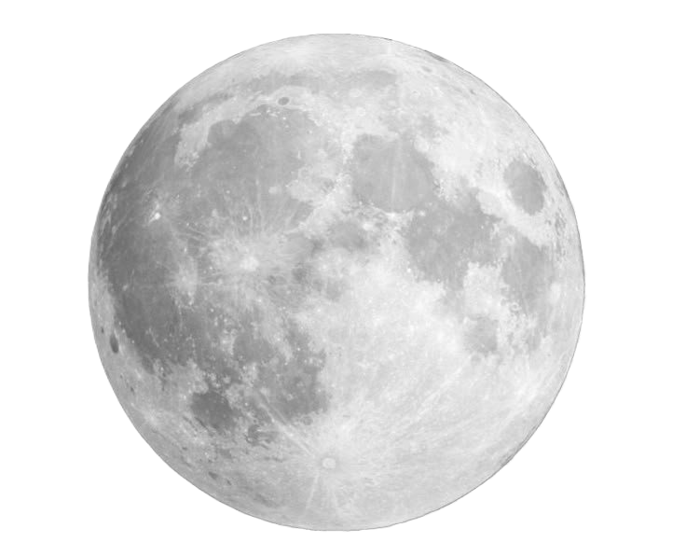
Thank You!
Kendall Kovacs
Check out our website!
Notes:
Thank you all so much for your time today. That completes our presentation and the floor is now open for any questions or feedback you all may have.

Slide 63
CFD Iterations: Force Calculations
Particle will loft when the drag force acting on the particle is greater than its weight.
A fan velocity as low as 0.5 m/s will cause the particle to loft
Number of individual particles give insight on the modeling complexity in a virtual simulation.
Density of simulant = 3.16 g/cc
Volume of simulant = 63.23 ${cm}^{3}$
Volume of simulant = 63.23 〖𝑐𝑚〗^3
Number of particles in 200g of simulant = 3.52$×{10}^{11}$
Number of particles in 200g of simulant = 3.52×10^11
Mass of one particle = 5.67$×{10}^{−13} kg$
Mass of one particle = 5.67×10^(−13) kg
Weight of one particle = $5.57×{10}^{−12} N$
Weight of one particle = 5.57×10^(−12) 𝑁
Velocity of fan = 2.57 m/s
Drag force on particle = $2.79×{10}^{−11} N$
Drag force on particle = 2.79×10^(−11) N

